Slide 1
SINGLE IMAGE SUPER RESOLUTION USING GENERATIVE ADVERSARIAL NETWORK
Under the supervision of
Prof. Sandeep Kumar Garg &
Prof. Pradumn K Pandey
Group members-(Group no. 4)
Bhanu 19535008
Mini Agarwal 19535019
Venkateshwara Packya Janeefa S 19535030

Slide 2
Abstract
Problem
How to recover the finer textual details of an Image
Existing Work
Focused on minimizing the pixel wise mean squared error, but the resulting images don’t have high frequency details despite of having higher PSNR values
Our Work
Concept of Perceptual loss which is the combination of adversarial and content loss. Adversarial loss helps the discriminator to differentiate between the generated images and real images and content loss is used to measure the perceptual similarity instead of similarity in pixel space between both the images.

Slide 3
Super Resolution
Super Resolution is the task in which High-Resolution(HR) images are obtained from its Low-Resolution(LR).
Convolutional Neural Networks
CNN are the deep learning networks that take images as input and produces results according to the requirements.CNN has three types of layers.
Convolution layer
Polling layer
Fully connected layer

Slide 4
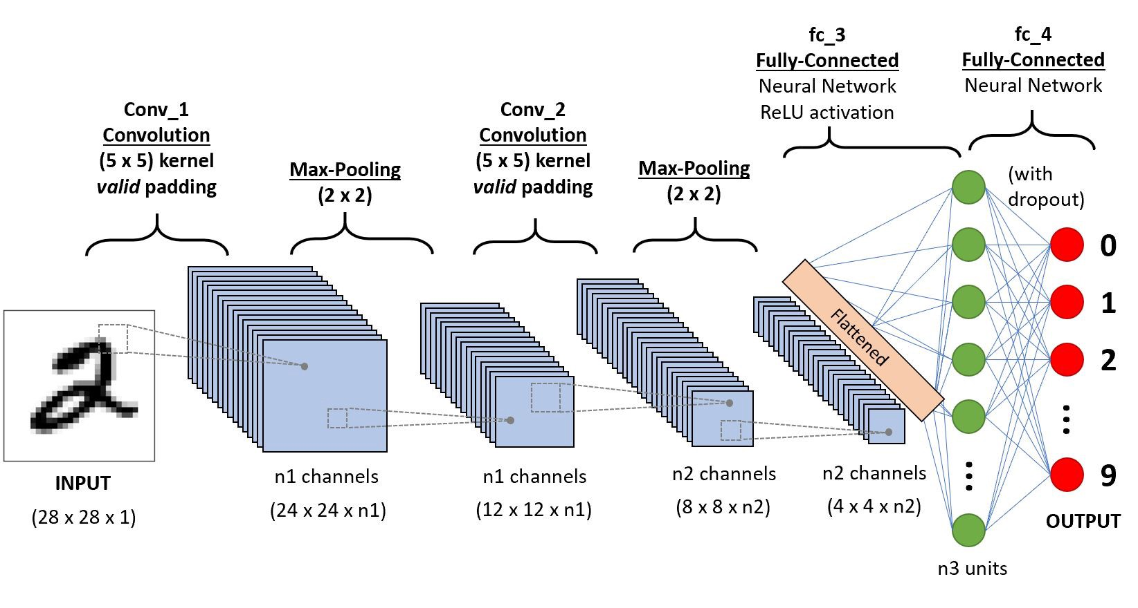

Slide 5
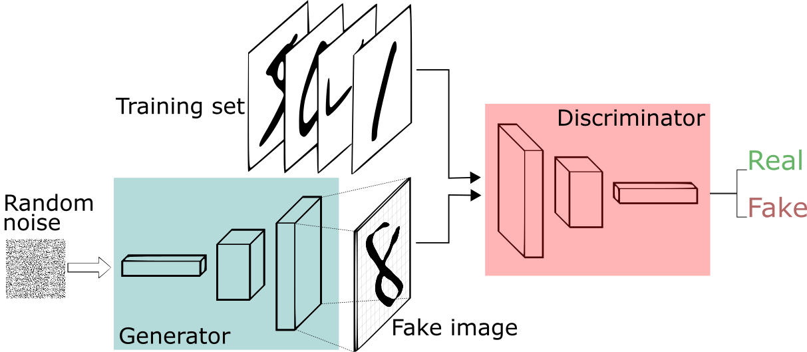
Super-Resolution Generative Adversarial Network(GAN)
Generative adversarial networks deep neural networks consisting of two main components a Generator and Discriminator.

Slide 6

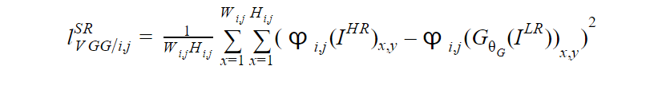
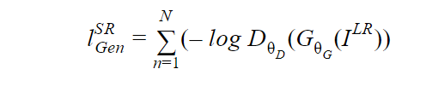
Perceptual Loss
Content Loss
2. Adversarial Loss

Slide 7
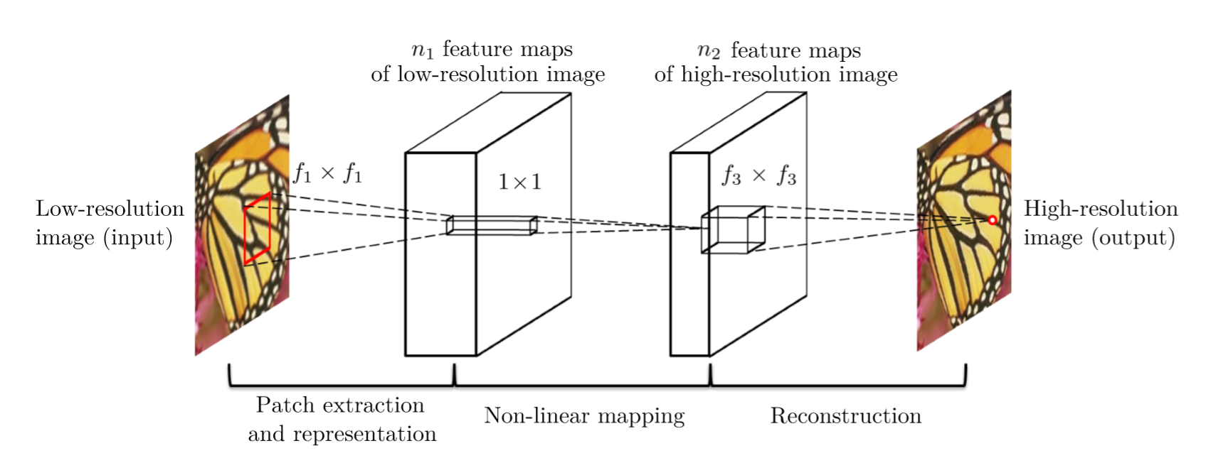
Literature Survey
Learning a Deep Convolutional Network for Image Super-Resolution

Slide 8
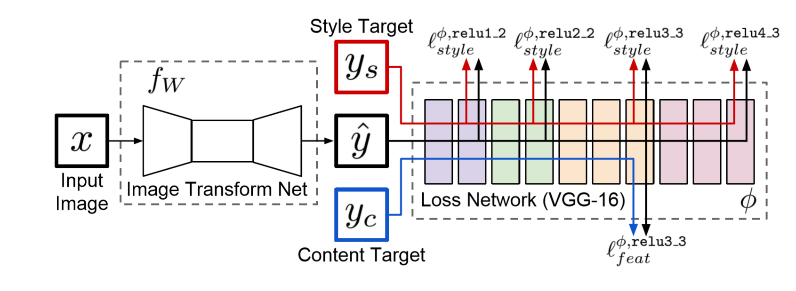
Perceptual Losses for Real-Time Style Transfer and Super-Resolution

Slide 9
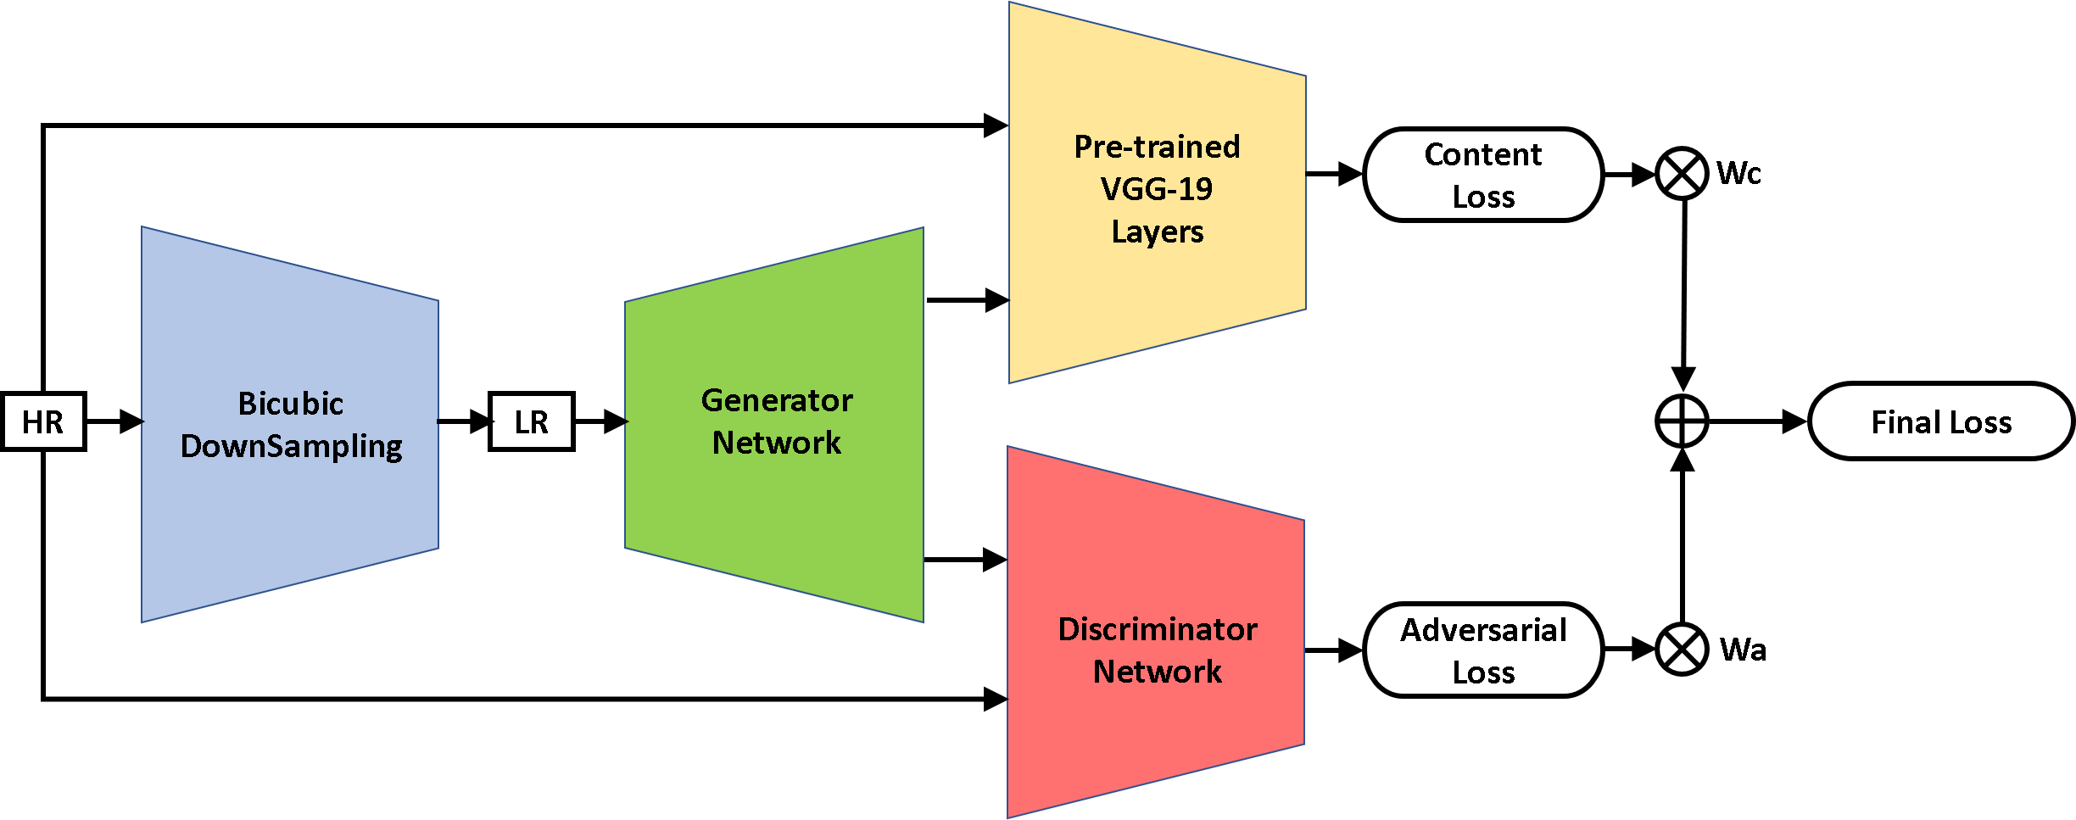
Our Work
Implemented the paper by Ledig et al[1].
Training Architecture:

Slide 10
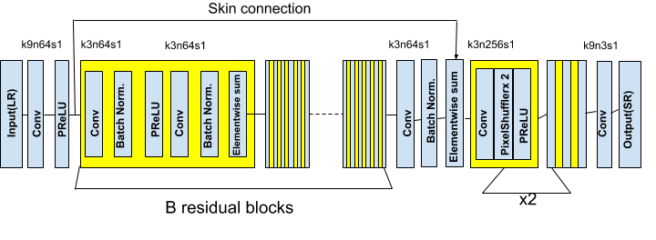
Generator Architecture:

Slide 11
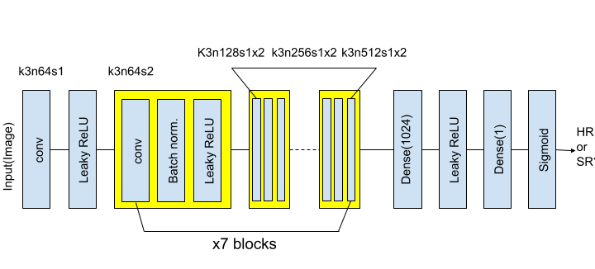
Discriminator Architecture:

Slide 12
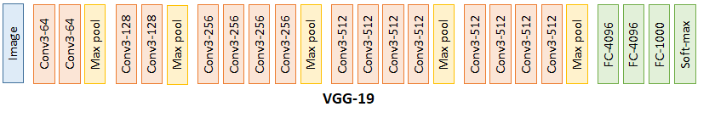
VGG19 Architecture:
Feature maps obtained after conv4_block5 are compared to calculate content loss.
VGG-19 is a convolutional neural network that is trained on more than a million images from the ImageNet database[2]
The network is 19 layers deep and can classify images into 1000 object categories, such as keyboard, mouse, pencil, and many animals.
As a result, the network has learned rich feature representations for a wide range of images.
.

Slide 13
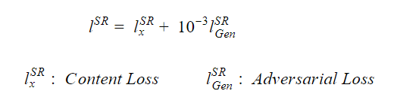
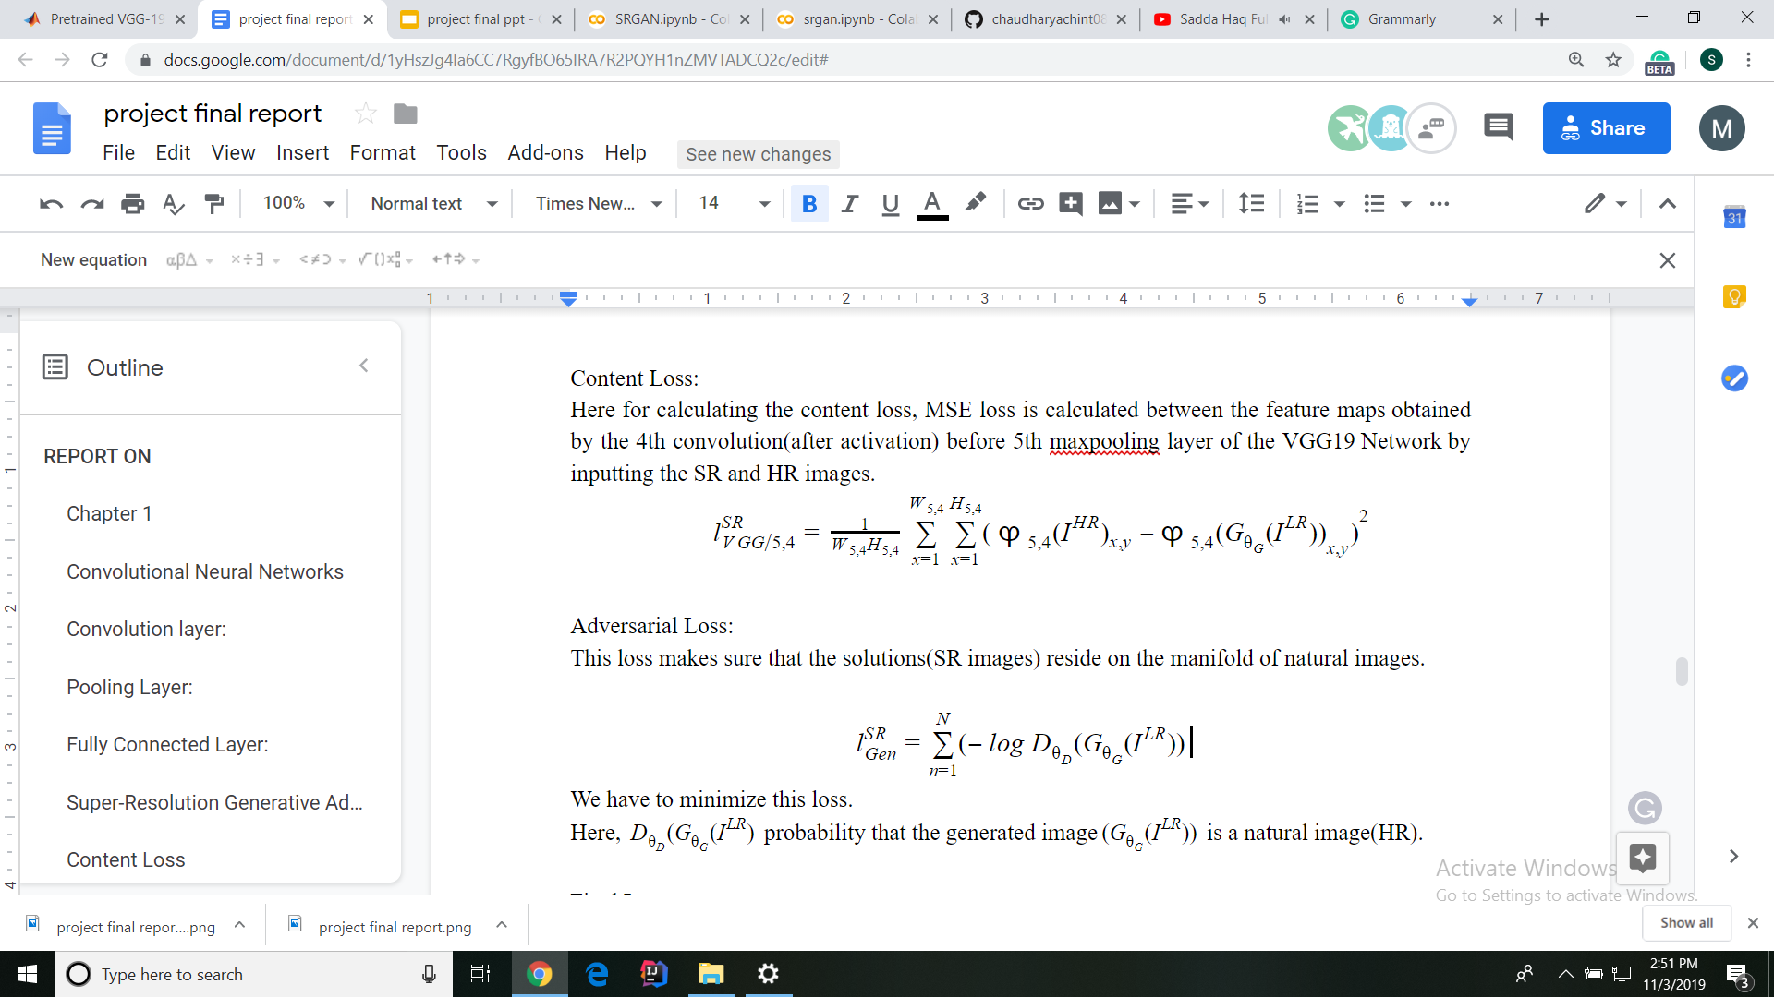
Total Loss function(Perceptual Loss)
Content Loss:
Adversarial Loss:

Slide 14
Training is done in two Phases:
Generator Training
HR images are downsampled to LR by using bicubic Downsampling.
The generated LR image is passed through the generator which upsamples the image and gives SR image.
Loss is calculated as Mean Squared Error(MSE) between the SR and HR image which is backpropagated back to train the generator.
GAN(Generative Adversarial Network) Training
In this phase both generator and discriminator are alternatively trained.
Firstly, the generator’s weights are updated according to the total loss(perceptual loss).
Secondly, the discriminator’s weights are updated according to the Adversarial loss.
The above two steps are repeated for the training of GAN.

Slide 15
Dataset used
Training: DIV2K dataset (800 Images)
Testing: Set5

Slide 16
Data reading & LR generation, with support for heterogeneous & multiformat images
In the datasets both LR and HR images of required dimensions are not present, therefore we have only collected HR images and then converted them in LR images using bicubic downsampling.
During the training phase, we are dividing both LR and HR images into patches of 24*24 and 96*96 resolution respectively.
The LR images are scaled in between the range of 0 to 1 and HR images are scaled in between the range of -1 to 1.

Slide 17
There are two approaches for patching of images:
The image is first downsampled and then broken down into patches for further processing.
The HR image is first broken down into patches of small size and then is downsampled for further processing.

Slide 18
Training Details:
We have trained our network on Google Collaboratory which provides a single 12GB NVIDIA Tesla K80 GPU using 800 images(after preprocessing) obtained from DIV2K dataset.
Adam optimiser is used with beta=0.9.
SRCNN network is trained with 10^-4 learning rate.
Updations made to the generator and discriminator are in alternate manner.
During testing batch-normalisation update is removed so the input deterministically depends only on the input.

Slide 19
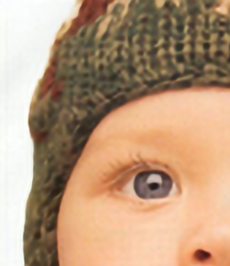
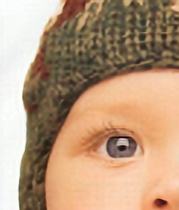

Results
PSNR: 32.50283199
SRCNN
PSNR:31.87665999
SRGAN
PSNR:30.83307666
LR

Slide 20
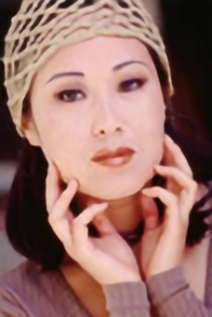


PSNR: 28.67756786
SRCNN
PSNR: 26.69596217
SRGAN
PSNR: 25.18124196
LR

Slide 21
In the our work, the results are as follows:
Set5 Results | SRCNN | SRGAN
Avg. PSNR | 29.84 | 28.6
Avg. MOS | 3.062 | 3.816
In the original Paper, the results are as follows:
Set5 Results | SRCNN | SRGAN
Avg. PSNR | 32.05 | 29.50
Avg. MOS | 3.37 | 3.58

Slide 22
Conclusion
As human based results(MOS) has more perceptual assessment quality than PSNR results(analytical Results), we can conclude that SRGAN is performing better than SRCNN as SRGAN’s MOS is better despite of having less PSNR.
Also, in comparison to the original paper our results are lacking a little bit, this is due to the difference in datasets used for training.

Slide 23
Future work
The extension to the work is done by Wang in the paper called ESRGAN.
maximize the PSNR
In this paper some changes are made to the SRGAN
Residual-in-Residual Dense Block (RDDB): easy to train, has high capacity and has dense connection.
Next, residual scaling is used and all the Batch Normalization (BN) is removed.
The discriminator using Relativistic average GAN (RaGAN) is improved. discriminator learns to identify one image is more realistic than other.
the generator to focus on more realistic textual details and learn about the sharper edges.This is done by replacing the standard discriminator by the relativistic discriminator.

Slide 24
The perceptual loss is improved by using VGG features before activation instead of after activation in which the distance between two activated features is minimized.By adjusting the perceptual loss we get the more sharper edge and satisfied subjective view than all the methods proposed so far.
ESRGAN generates the better super resolution image from the low resolution image than any other SR methods.
No method cannot be used for x8 upscaling.

Slide 25
References
Ledig, Christian, et al. "Photo-realistic single image super-resolution using a generative adversarial network." Proceedings of the IEEE conference on computer vision and pattern recognition. 2017.
Russakovsky, O., Deng, J., Su, H., et al. “ImageNet Large Scale Visual Recognition Challenge.” International Journal of Computer Vision (IJCV). Vol 115, Issue 3, 2015, pp. 211–252

